Slide 1
SecTalks SYD0x0e CTF
Solution Walkthrough
Kris Hunt

Slide 2
Who Am I?
Kris Hunt – SOC Manager for Symantec in Sydney
Working in InfoSec for about 17 years
CTFing for about the past 18 months on team “Capture The Swag” currently sitting at about rank 38 in the world
Self Promo:
Twitter: @CTFKris
CTF Writeups: https://ctf.rip
Github: https://github.com/sourcekris/
Linked in: https://au.linkedin.com/in/huntk

Slide 3
My Approach to Challenges
CTFing is usually about timing
Speed and results are important, perfection is not important
Solve quickly so you can move to the next challenge
Having a challenge “pipeline” or standard methodology helps, especially when learning to CTF
Repeatable process lends itself to learning the scope of new challenges in the least possible time
Can help you spot things you might otherwise miss when you skip steps and jump straight into static analysis etc

Slide 4
My Challenge Pipeline
Take note of the entire challenge clue including specifically
The category
Point value (if applicable) and point value in relation to other challenges
All words in the clue, misspellings, unusual acronyms, bolded words etc can be hints
All of the given files
E.g. An exploit category challenge where a libc binary is also provided is usually a big hint to the solution they expect you to find requires returning into libc
Identifying all components
File types, web server versions, the language the web challenge is written in, the cipher block mode of operation for example
The normal use case
RE challenge: What happens when you just run the binary?
Web Challenge: Sign up normally to the web site?
Crypto challenge: Encrypt a simple plaintext?

Slide 5
My Challenge Pipeline
Research
Past CTF write-ups are usually where challenge authors get their inspiration. Read them.
Basic Fuzz Testing
Exploit challenges, you might find the broken code faster by iterating the program by hand than pouring over IDA Pro graph view
Static analysis
Objdump, radare2, IDA Pro
Dynamic analysis
gdb, radare2, IDA remote debugger
Code
What language will get you a result faster? E.g. if you’re breaking a PHP application, it might be faster to stick to a PHP solution.
Generally Python is the go-to for CTFing
Solve

Slide 6
POC.EXE Solutions

Slide 7
The Clue
Find a way to print the "win" message.
Category: Reverse engineering
Points: 400
Author: CreateRemoteThread (Norm)
Rules
No patching the binary on-disk or in-memory (you can do this, the binary is not obfuscated on purpose).
There is no "flag" - the point is to get to the "win" message and tell everyone how you did it.
There's many ways to skin a cat - the most obvious solution may not be the easiest.
Hints
Write a python parser (pwntools)
There's an intentional buffer overflow (i.e. set a value on the stack to X).

Slide 8
Pipeline – First Steps
Read the clue and hints – the stack overflow thing looks interesting
Identify the file
root@kali:~/sectalks# file poc.ex_
poc.ex_: PE32 executable (console) Intel 80386, for MS Windows
The normal use case prints this message very slowly then asks us to solve math problems:
root@kali:~/sectalks# wine ./poc.exe
*** MIRROR MIRROR ON THE WALL
*** WHO IS THE MOST EXCELLENT OF THEM ALL?
*** SOLVE THE FOLLOWING MATHS PROBLEMS TO FIND OUT!
Question 1 of 500 : What is the sum of 050100 and 15203?
>

Slide 9
Pipeline – First Steps
Identifying some key points:
The challenge at first glance is “challenge response”
Typically found as a PPC (professional programming category) not as RE
The output delay is a big problem for impatient me – want to patch it out
The integers display as mixed bases
Prefixed with zero should be octal
Prefixed with 0x should be hexadecimal
No prefix should be treated as decimal
Four math operations:
Sum, product, modulus, difference
Still need to take the “hint” into account about the stack overflow
Windows binaries are a problem…
Research – We can find similar CTF challenges with write-ups before, but none directly copy+pasteable

Slide 10
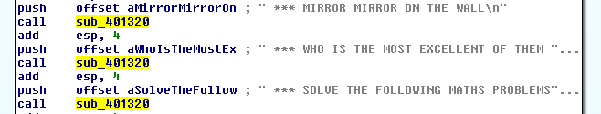
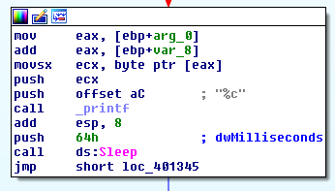

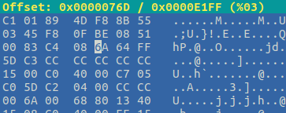
Pipeline – Static Analysis – Patch the Delay
From main()
sub_401320()
Finding this in the poc.exe file at offset 0x76d and change 0x64 to 0x00:
Switch to Hex View:

Slide 11
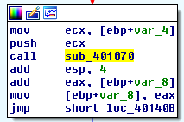
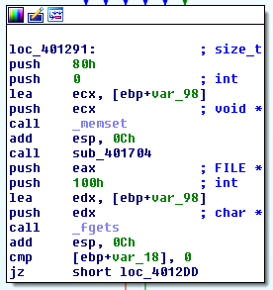

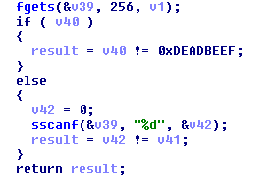

Pipeline – Static Analysis – The Overflow
From main()
Excerpt from sub_401070()
IDA Decompilation
…
…
fgets() 0x100 bytes onto the stack
Compare the integer stored 0x80 bytes from the beginning of the input buffer to 0xdeadbeef

Slide 12
Pipeline – Dynamic Analysis
Since this is a Windows binary, we can use Immunity or OllyDbg for dynamic analysis
We focused on confirming the offset of the buffer overflow using a “cyclic pattern” string

Slide 13
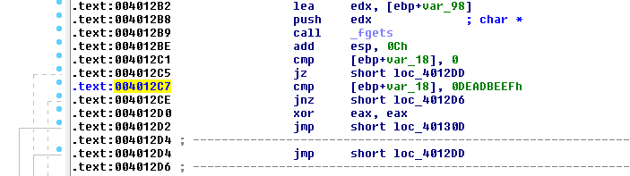
Pipeline – Dynamic Analysis – The Overflow
Excerpt from sub_401070()
Text view of same code we note the location of the cmp instruction:
Create a cyclic pattern string using Metasploit framework tools:

Slide 14
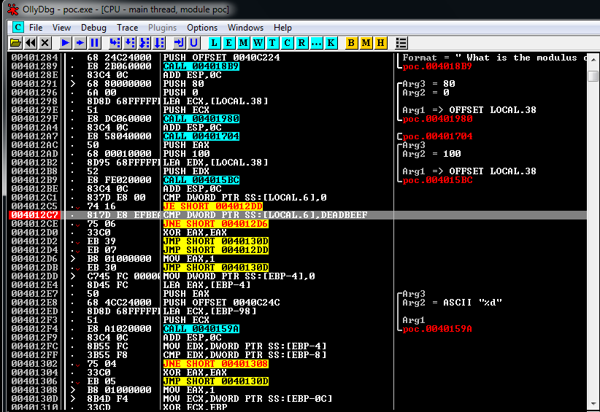
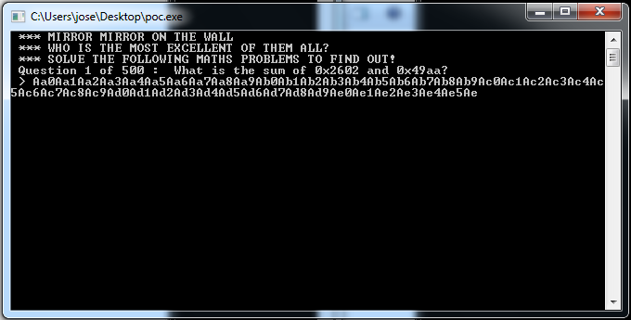
Pipeline – Dynamic Analysis – The Overflow
Start OllyDbg, set a breakpoint at 0x4012c7 and run the program:
Paste the cyclic pattern string in at the prompt:

Slide 15
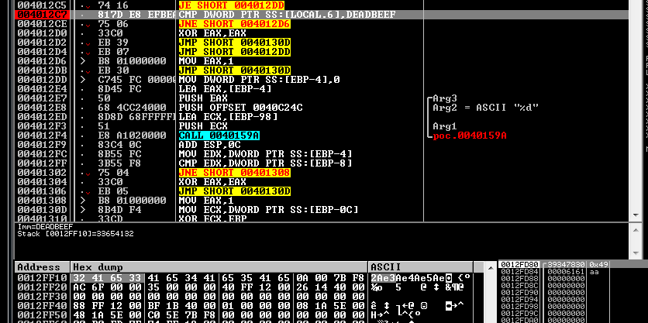
Pipeline – Dynamic Analysis – The Overflow
The breakpoint will be reached and you can see the value comparison is occurring between the constant 0xDEADBEEF and the value at memory location 0x12FF10:
You can then find the offset of this value from the beginning of your input string using Metasploit framework tools again:

Slide 16
Pipeline – Dynamic Analysis – Conclusion
So this solution would be to fill the input buffer with 128 bytes (of anything) and then the four bytes 0xDE 0xEA 0xBE 0xEF in little endian byte order
You successfully do this, then the sub_401070() will return true and you can ignore the math

Slide 17
My Solution
At this point I realised it would be cumbersome to exploit the overflow, not impossible just annoying
The overflow avoids simple math but working with Windows is annoying
Using Wine gave unpredictable results for the buffer overflow in my environment
So our solution uses Python, imports the “pexpect” module and runs the binary in Linux under Wine and simply does the math problems
Source Code: https://github.com/sourcekris/sectalks

Slide 18
Today’s CTF

Slide 19
The Clue
Category: Web (Flags 1 and 2), Forensics (Flag 3)
Scenario:
You’re having trouble recovering your important files from the website since your account was deleted. You know “john” has an account but you don’t know his password. Can you login anyway? (flag 1)
John doesn’t have access to the files, but admin does. Can you get admin access? (flag 2)
The file seems to be encrypted, can you decrypt it? The flag is inside somewhere. Analysis of the file is required. (flag 3)
Link: http://52.63.238.93 (http://ctf.acceptable.website)
Hints
MySQL is the DBMS behind the site
All flags are in the format flag{<hashhere>}

